Slide 1
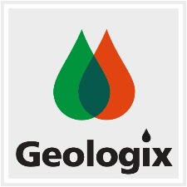
Imagine • Innovate • Inspire
Geo-RAG Chatbot: AI-Powered Document Question Answering
Project Summary & Achievements
Haocheng Lin

Slide 2

Project Motivation & Objective
Objectives
Challenge: Difficult and time-consuming to perform manual search through the technical documents.
Requirement: Users need accurate and prompt responses from Q & A sessions on large structured data.
Objective: Build an AI chatbot for answering questions about domain-specific documents.
2
© Geologix Limited

Slide 3
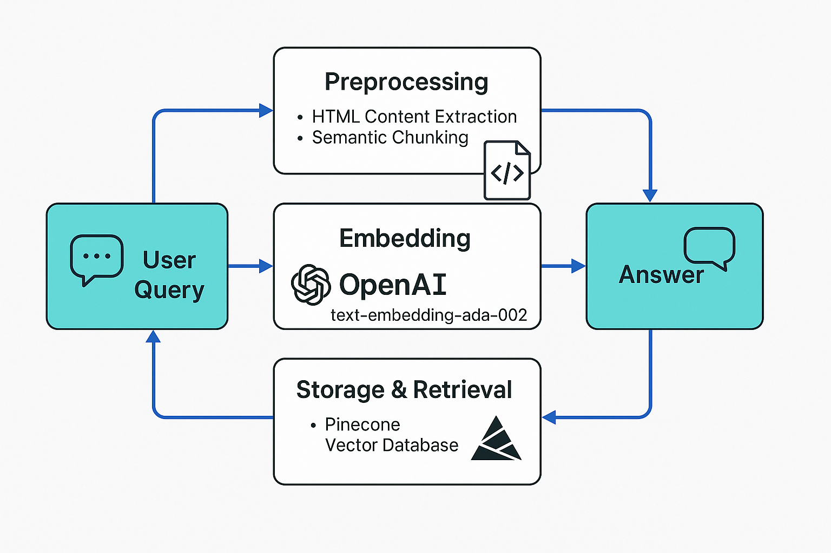
System Architecture
An End-to-End System Design
Input: User Query
Preprocessing: HTML content extraction and chunking
Embedding: text-embedding-ada-002
Storage & Retrieval: Pinecone vector database
Response: GPT-4o-mini generates an answer.
3
© Geologix Limited

Slide 4
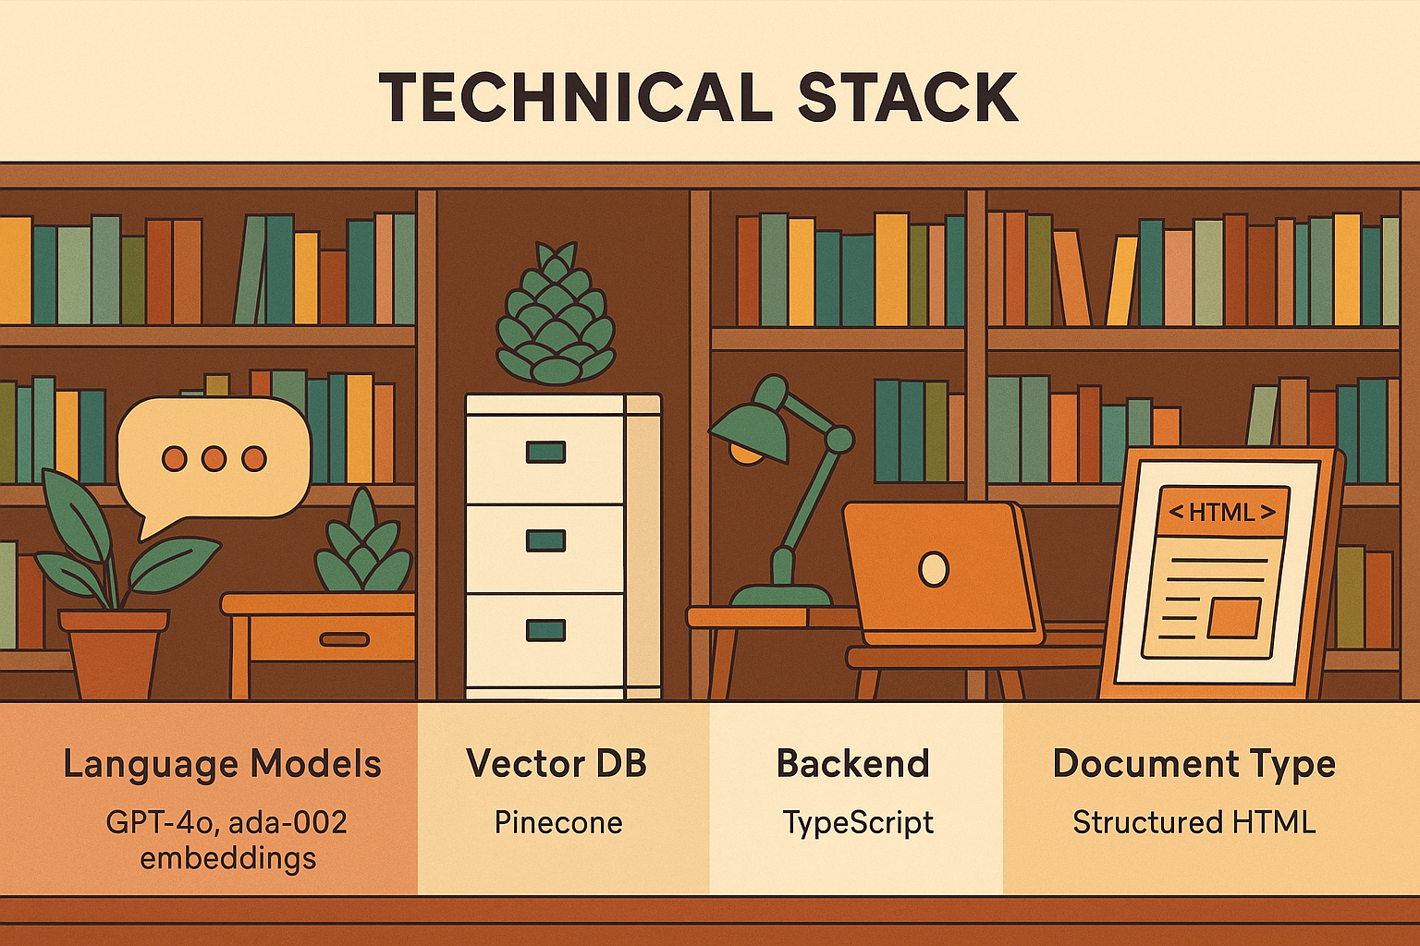
Technical Stack
Technologies Used
Language Models: GPT-4o-mini
Vector DB: Pinecone
Backend: Typescript
Frontend: HTML & CSS
Document Type: Structured HTML (e.g., GEO_Limits)
4
© Geologix Limited

Slide 5
Achievements
What I have achieved:
Functioning prototype with full document-querying capabilities.
Performed semantic search to retrieve relevant extracts.
Modularized architecture for ensuring future scalability.
Fine-tuned and optimized RAG model for accuracy and performance.
5
© Geologix Limited

Slide 6
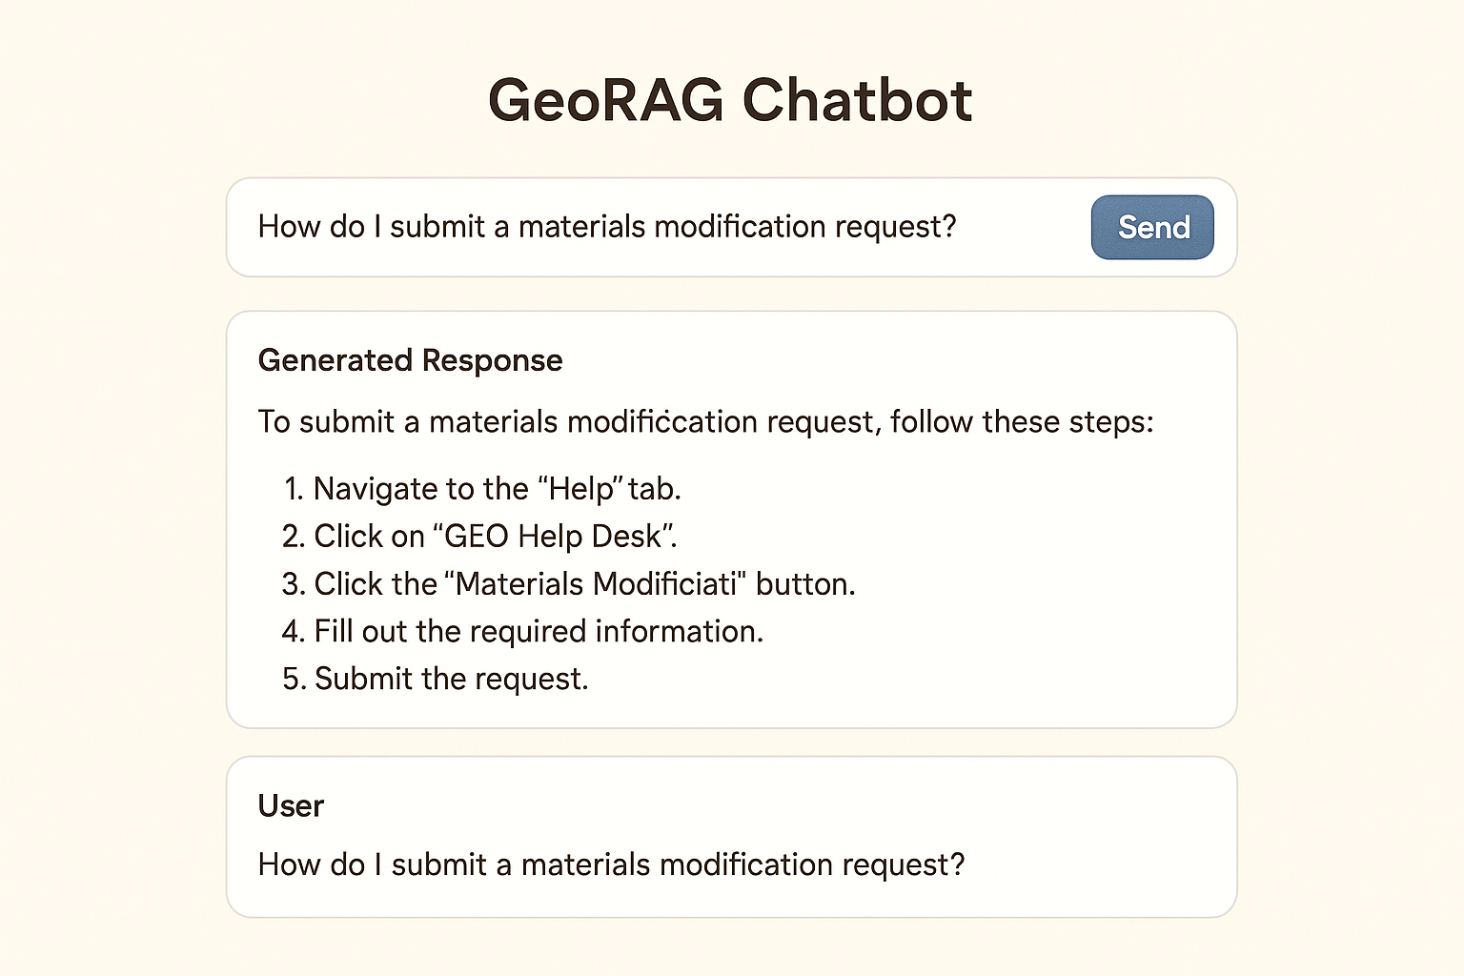
What’s Next?
Future Improvements
Improve front-end UI layout.
Support querying across multiple documents.
Cache previous interactions to improve user experiences.
Integrate user feedback to improve the model’s performance.
6
© Geologix Limited

Slide 7
Imagine • Innovate • Inspire
Thank You

